Slide 1
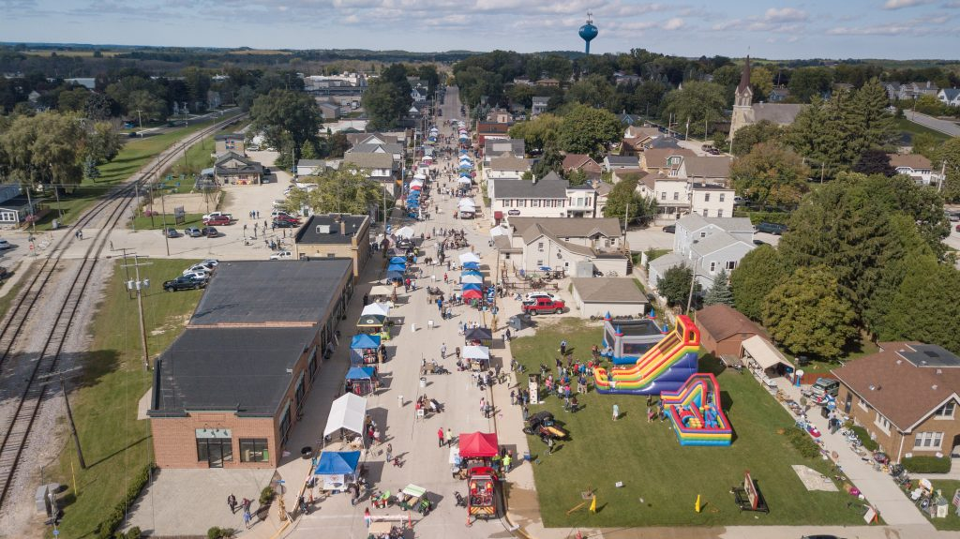
Our Home Trending
Random Lake, Wisconsin

Slide 2

Agenda
Advantage Random Lake Group
Why are we here?
Current Challenges
Community Survey
Demographics & Trends (Ecosystem)
Possible Solutions
Development Hotspots

Slide 3

Advantage Random Lake
Core Group
David Borchardt | Commerce State Bank
Cory Davis | Robert W. Baird
John “Jack” Scholler | Times Printing (retired)
Brian Depies | SEH
Chuck Van Horn | Van Horn Auto
Dane Checolinski | Sheboygan County Economic Dev’t Corp
John Rassel | Krier Foods
Mike Trimberger | Random Lake Area Schools
Miriam Leavitt | Random Lake Area Schools
Doug Miller | Sher-Homes Farms
Invited Members
Robert McDermott| Village of Random Lake
Ted Neitzke | Random Lake Area Chamber of Commerce
Notes:
Encourage development
Think tank

Slide 4
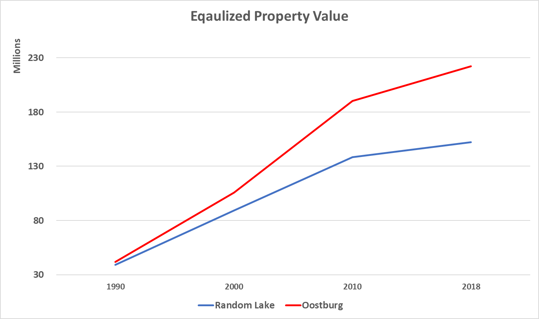
Why…Area is growing
Equalized Property Value
Notes:
Encourage development
Think tank

Slide 5
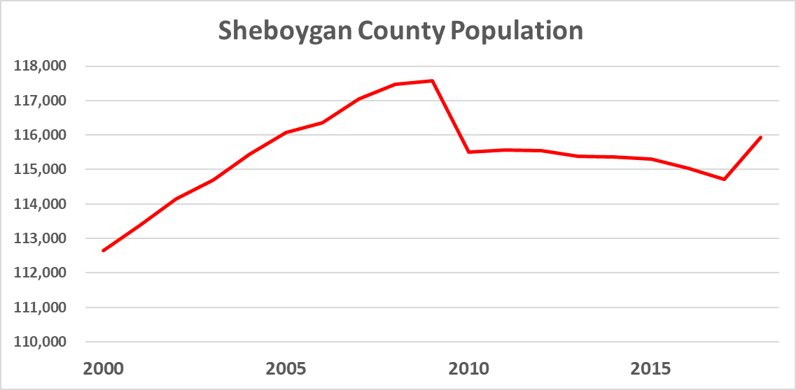
County Population
Source: Wis Dept. of Administration
Notes:
Impact of last recession. Stalled, reversed growth. County picked up.

Slide 6
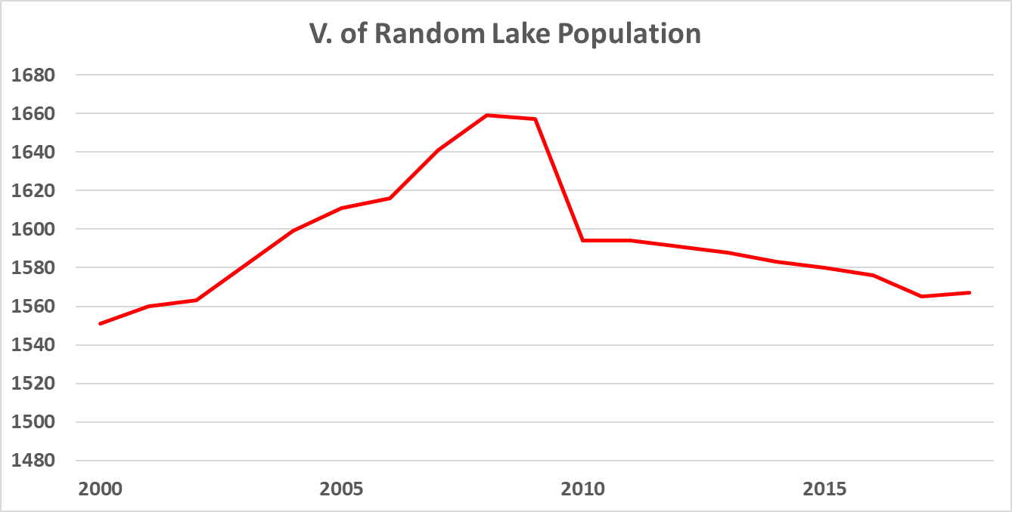
Random Lake Population
No Bump
Source: Wis Dept. of Administration
Notes:
Random Lake still stalled

Slide 7
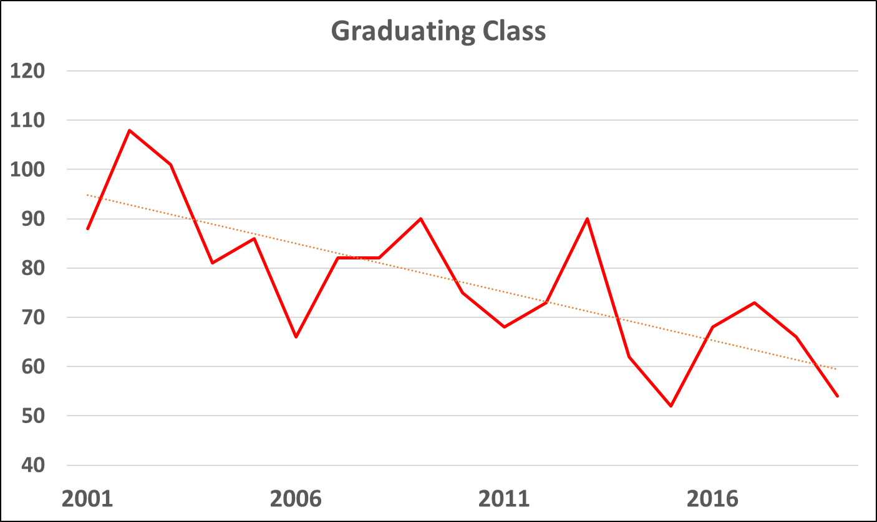
Random Lake School District
Source: Random Lake Area School District
Notes:
Gradating classes have been getting smaller.

Slide 8
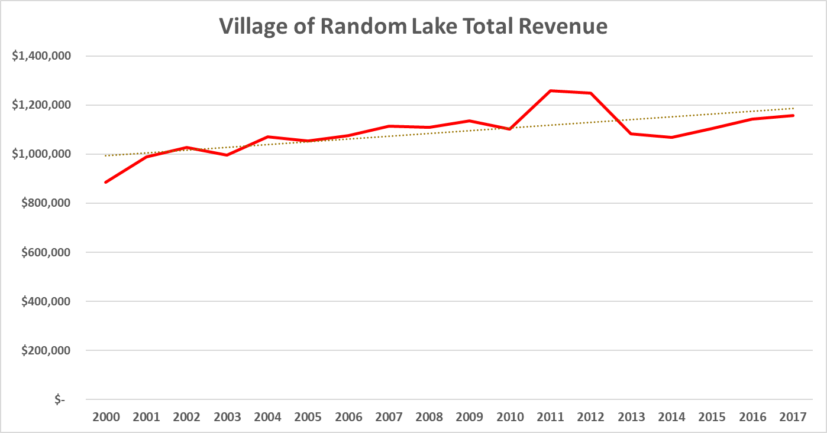
Village Revenue Trends
Source: Village financial statements
Notes:
Nominal dollars shows a nice upward trend

Slide 9
Inflation Impacts
Wages & health insurance
Road building materials
Fuel ($1.50/gallon in 2000)
Inflation index by US Bureau of Labor Standards (BLS)

Slide 10
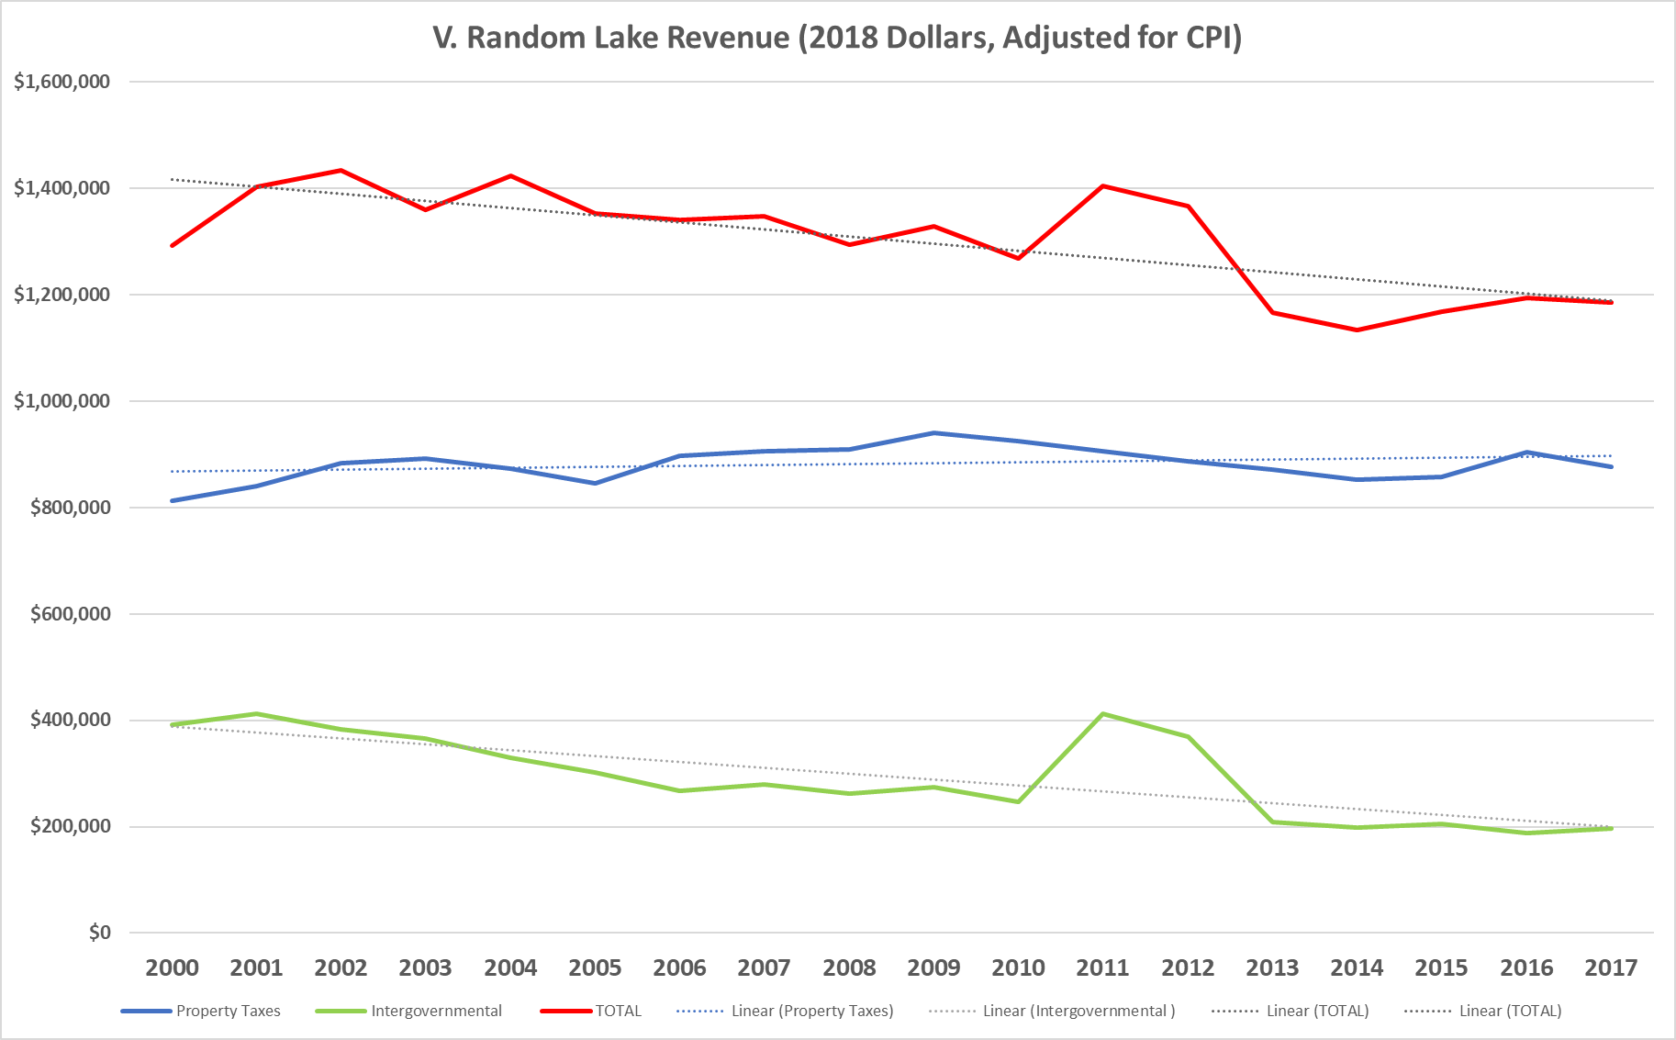
V. RL Budget (Consumer Price Index Adjusted)
TOTAL
Property Tax
Intergovernmental Revenue
Notes:
Real dollars shows decrease.

Slide 11
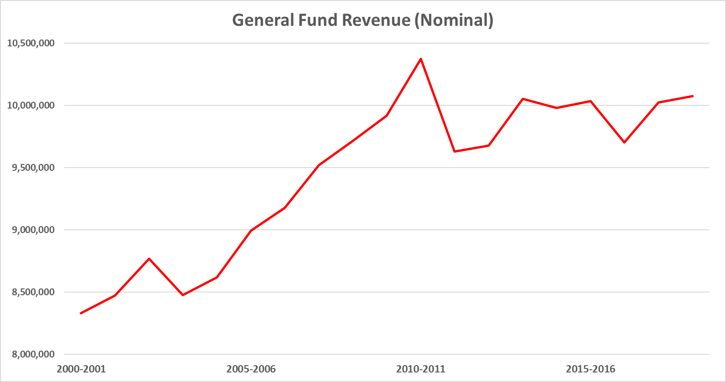
Random Lake School District
Source: Random Lake Area School District
Notes:
Nominal dollars

Slide 12
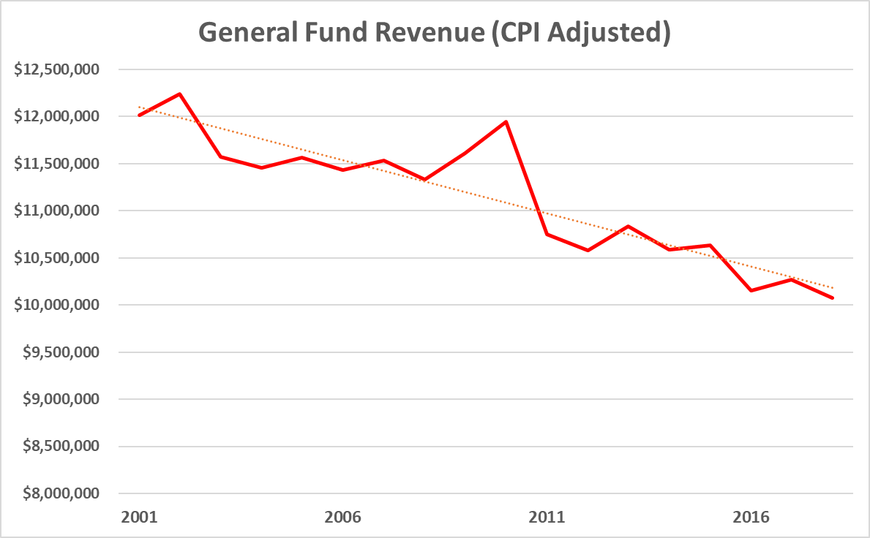
Random Lake School District
Notes:
Real dollars

Slide 13
20-Year Community Survey
Who Performed the Survey?
  UW-Extension for planning (feedback desired)
Who Took the Survey?
  Voices – 284 households, 31%
  Age – skewed high, 63% were 55+
  Ownership – 89% owned homes

Slide 14
20-Year Community Survey
How do residents feel about growth?
  73% wanted population growth
Open ended: What businesses, services or facilities would you like to see?
  160 – Grocery Store
  54 – Restaurant

Slide 15
20-Year Community Survey
Ranking: Which challenges face the village?
  1 – Lack of population growth
  2 – Declining vitality of downtown
  3 – Aging infrastructure
  4 – Stagnate tax base
  5 – Declining enrollment at Random Lake School
  6 – Lack of land for development
  7 – Lack of housing options
Notes:
3-4 homes for sale at a time.
Apartments continue to be full.
Without more housing options. We cannot grow. Increase capacity. Proper growth can help with downtown, tax base to pay for infrastructure and result in stabilized enrollment.

Slide 16
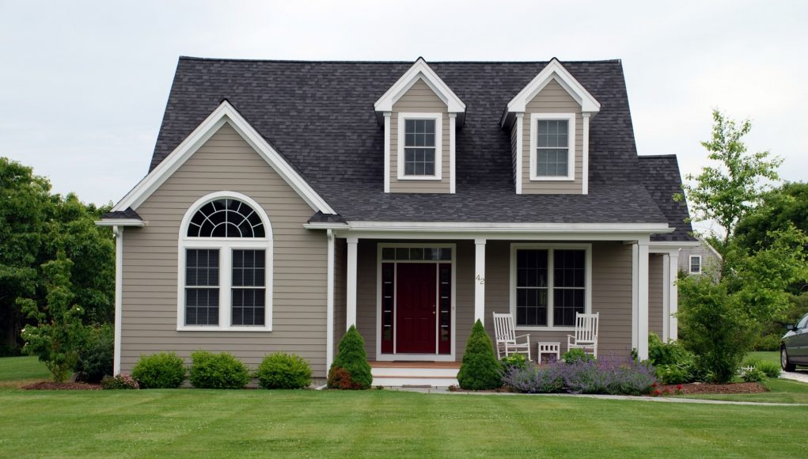
What type of housing should be allowed?
  88% Single family
  57% Condominiums (up from 36% in 2004)
  27% Affordable housing
  25% Multifamily
Source: Random Lake Survey
Notes:
Question is what type? The survey stated what people wanted.

Slide 17
Survey’s who ask preference questions tend to follow historic trends and not current and future housing needs.
Here is what the data and trends support…
Notes:
What people want and what they need simply don’t align.
In month of July. Chamber made aware of 1) new owner of firm looking for 2nd home here, 2 Engineering interns from Western Michigan (short term), New manager buy house with 4 kids and new priest for local church (single dude).

Slide 18
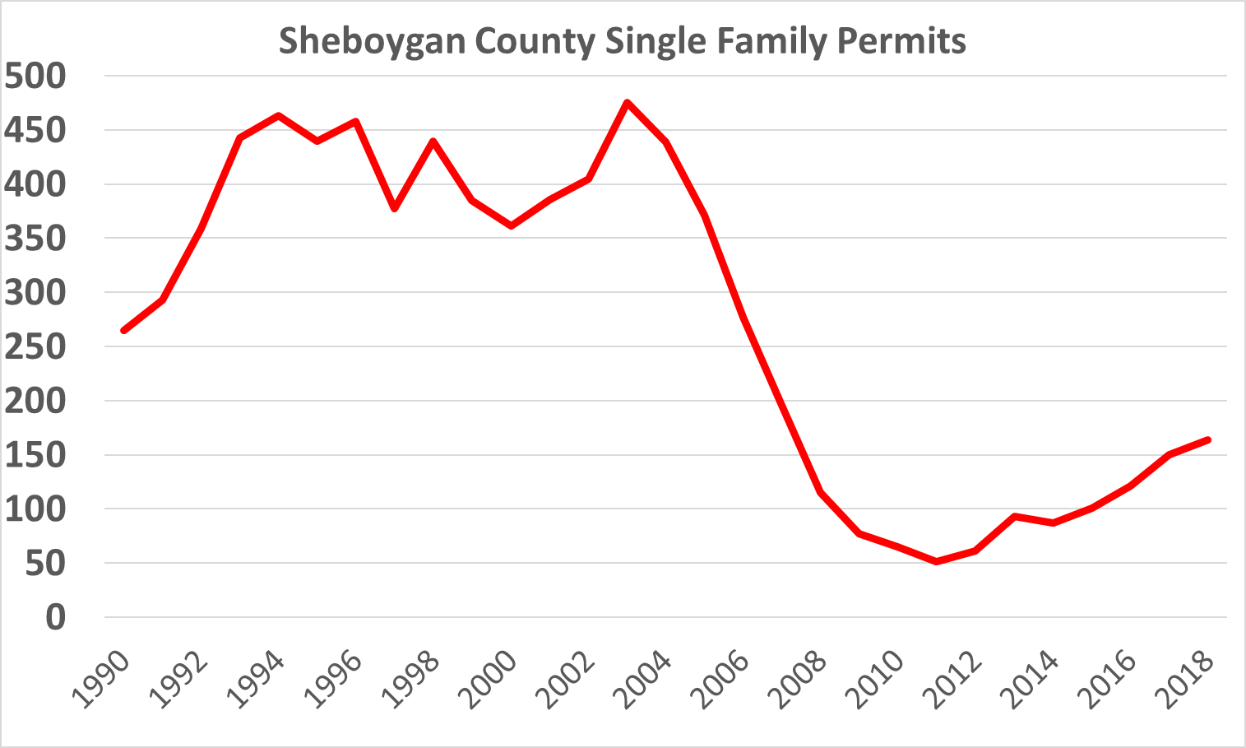
County Construction Trends
Single-Family housing
is no longer given
Source: US Census & Wis. DSPS
Notes:
Is single family being built in the area?

Slide 19
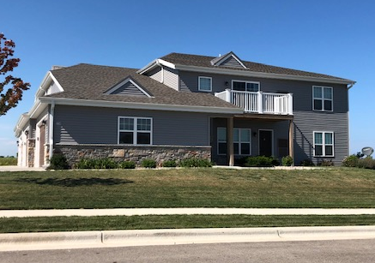
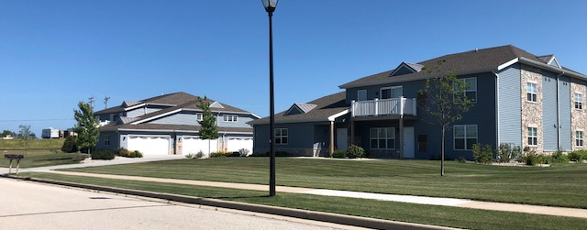
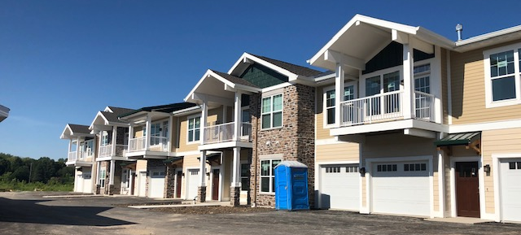
Allowing for Population Growth
2016-’19 Units
693 Open
399 Construction
344 Proposed
1,400+ Units
Source: SCEDC
Notes:
Upscale, respectable apartments. Retirees and Yong professionals live together. Fitness centers, covered parking, views, walkable to downtown and water frontage.

Slide 20
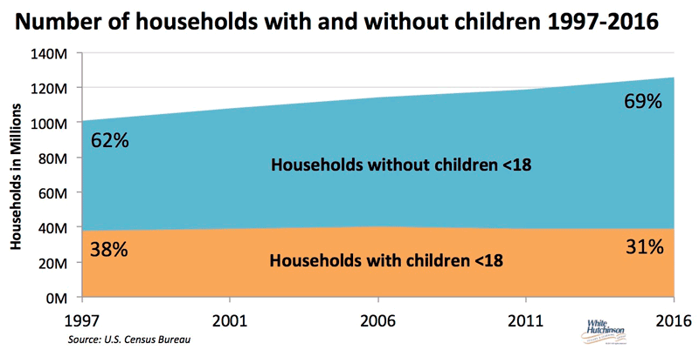
Households with Children
Notes:
Households with children only grew by 1 million.

Slide 21
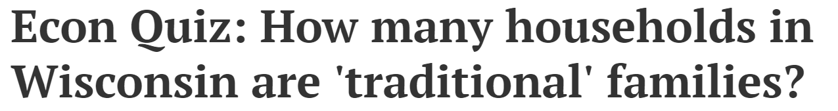



County Trends
18.4%
Source: Wisconsin State Journal, July 22, 2015
Notes:
Research has always shown traditional families own homes. Take a guess on how many households are traditional families in Wisconsin? Mom, dad with kid(s)?

Slide 22
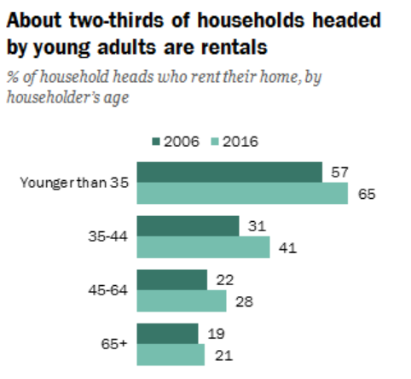
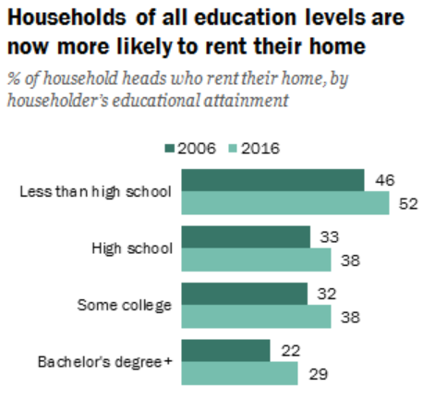
Simply More Renters
Source: https://www.pewresearch.org/fact-tank/2017/07/19/more-u-s-households-are-renting-than-at-any-point-in-50-years/
Notes:
No matter what age group. No matter education level. % of renters has increased. What you don’t see is that many homes that were once owner-occupied are now rentals. How many of you have a neighboring house that is a rental today that it wasn’t 10-20 years ago?

Slide 23
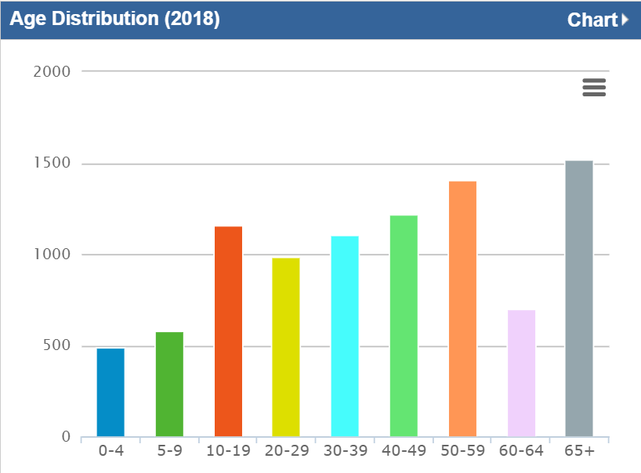
5-Mile Age Distribution
Future Housing Needs
Likely
Renters
Likely condo & smaller home
Likely Condo, Rentals & Assisted Living
Source: Applied Geographic Solutions, 2018 (LocateinWI.com)
Notes:
Local demographics suggesting a different need that residents are looking for.

Slide 24
Random Lake Income

Slide 25
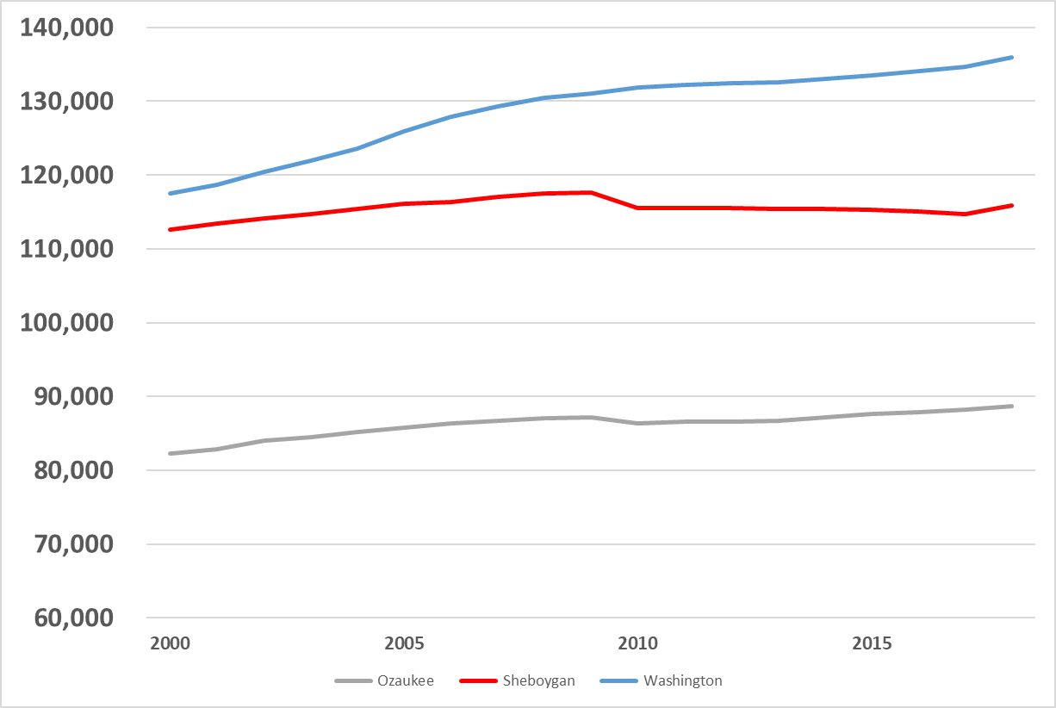
County Population Trends
Washington
Sheboygan
Ozaukee
Source: Wis. Department of Administration
Notes:
All surrounding counties are growing in population.

Slide 26
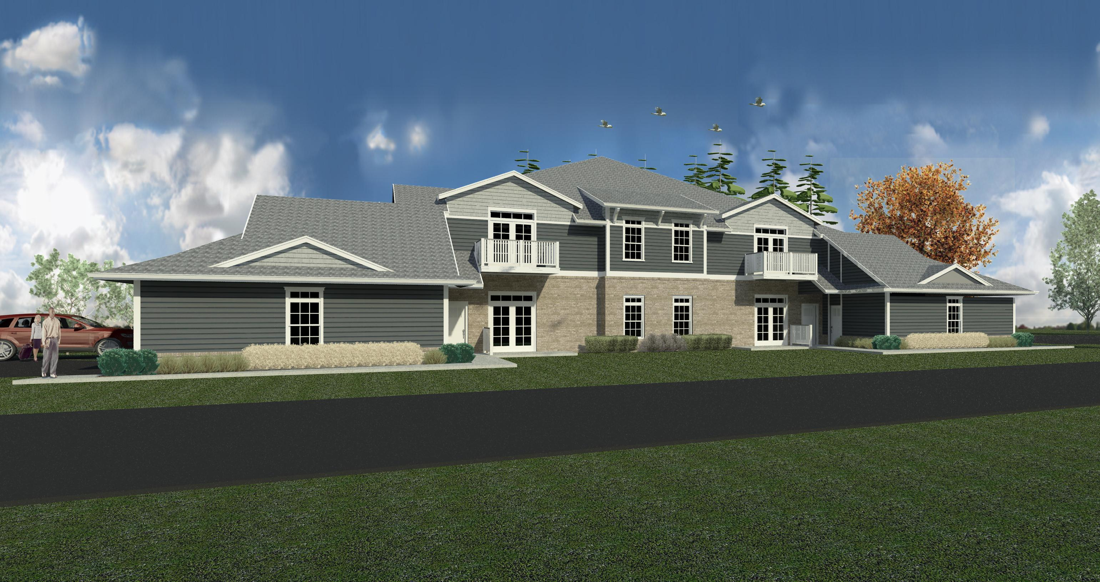
What we know - Community
Revenues to support community institutions not keeping up with inflation
County population growing, spurred by rentals

Slide 27
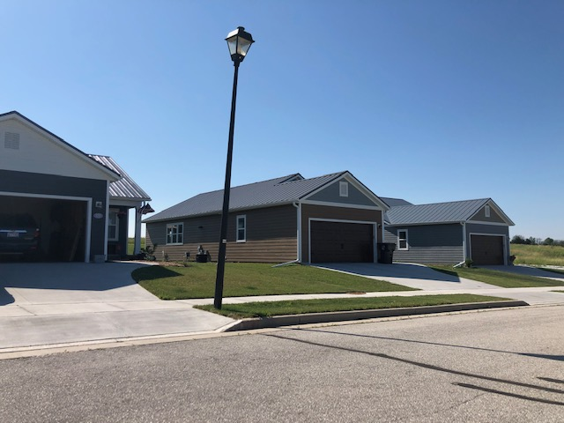
What we know - Preferences
50 and older is largest demographic (downsize)
10 to 19 age also significant demographic (rent)
Todays modern families require more diversified housing than in past

Slide 28

Unemployment Rate
2.5%
2.7%
2.6%
3,000+ jobs posted
Source: Feb. 2019 Unemployment Rate – Wisconsin DWD
Notes:
Great news. The area has a ton of economic opportunity. We have jobs and a lot of them.

Slide 29
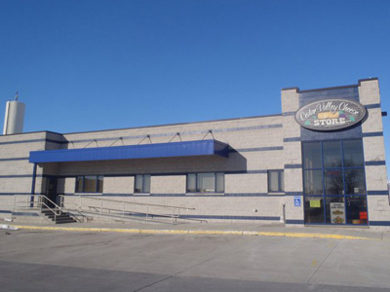

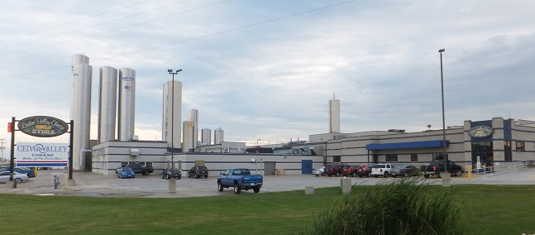
Cedar Valley
Notes:
Local firms are investing.

Slide 30
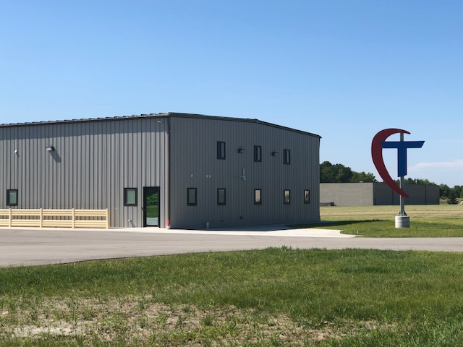
Trango Systems
Notes:
Movement and lots becoming available.

Slide 31
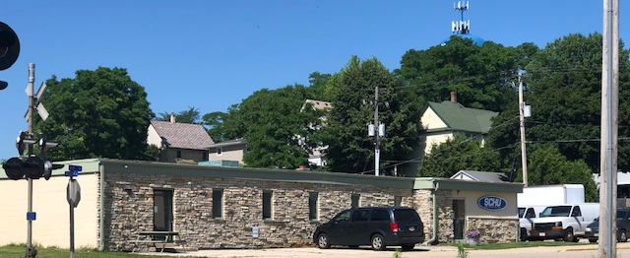
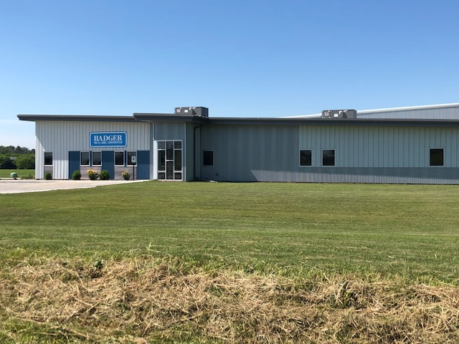
Growing Firms
Notes:
Movement and lots becoming available.

Slide 32
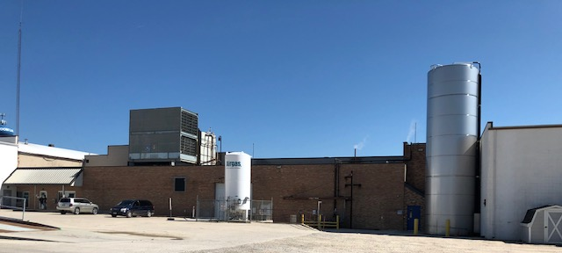
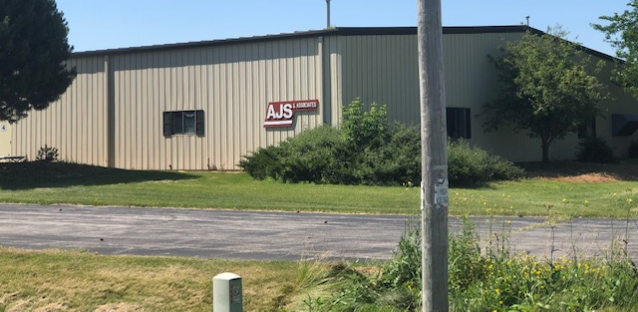
Growing Firms
Notes:
Movement and lots becoming available.

Slide 33
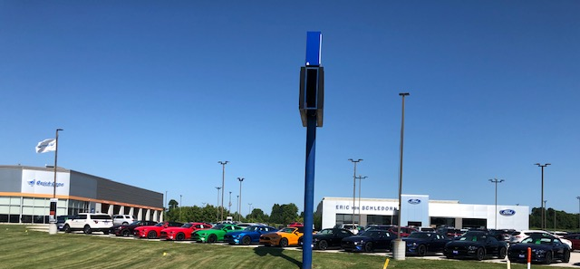
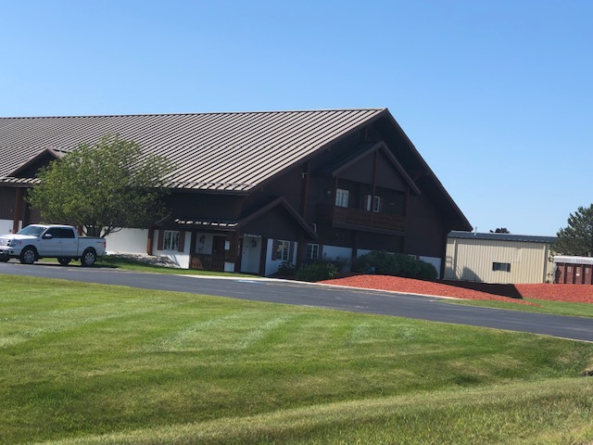
Growing Firms
Notes:
Movement and lots becoming available.

Slide 34
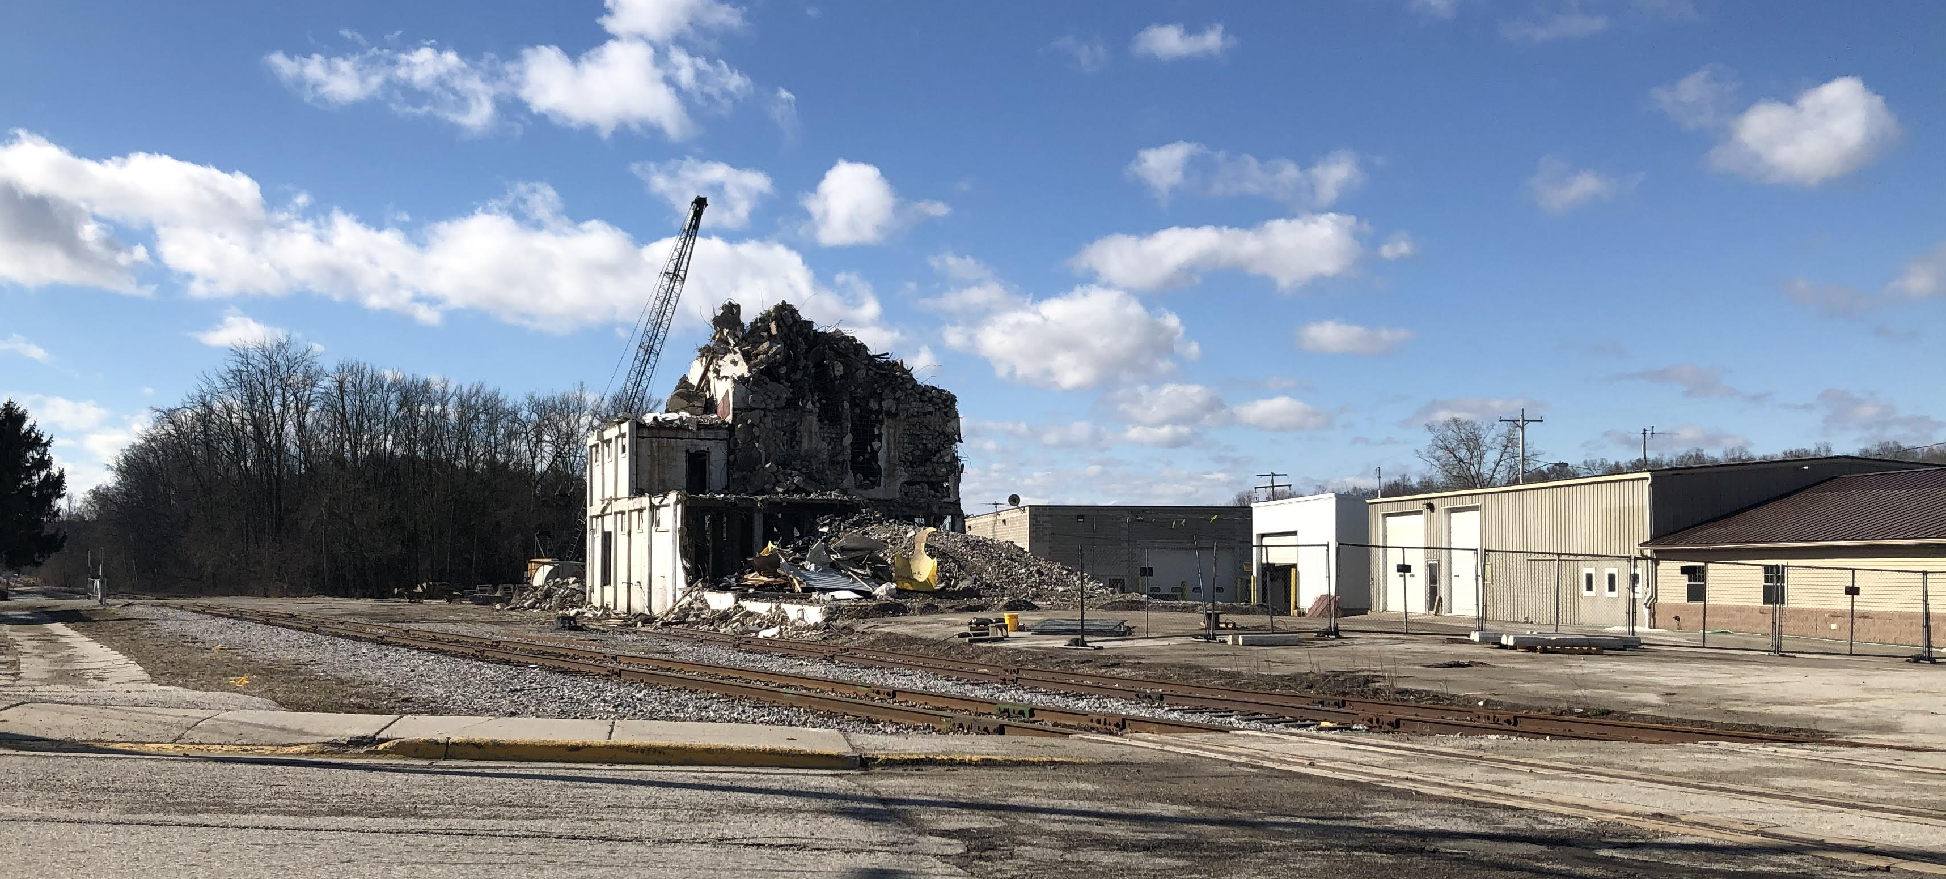
Properties Changing
Notes:
Movement and lots becoming available.

Slide 35
Growth as a part of the solution
Housing focused on population spikes of 50’s and Teens
  Desirable rentals to keep people here.
  Condos to free up single family households.
  Smaller homes to accommodate downsizing and smaller families.
Support existing employers
  Housing for prospective employees
  Have land available
Welcome & encourage verticality (>2 story buildings)
Community to become a progressive partner
Developments must produce ROI

Slide 36
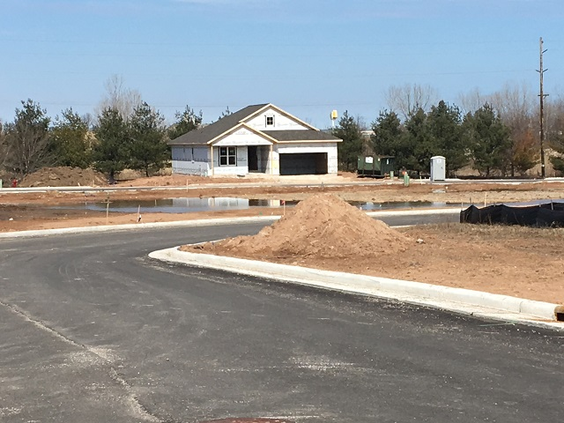
Solution Concepts: Sheboygan Falls
Vintage Zoning
Special Assessment
Solution Concepts: Belgium
Smaller lots & homes
TID
Notes:
Accept limited risk and encourage density in development.

Slide 37
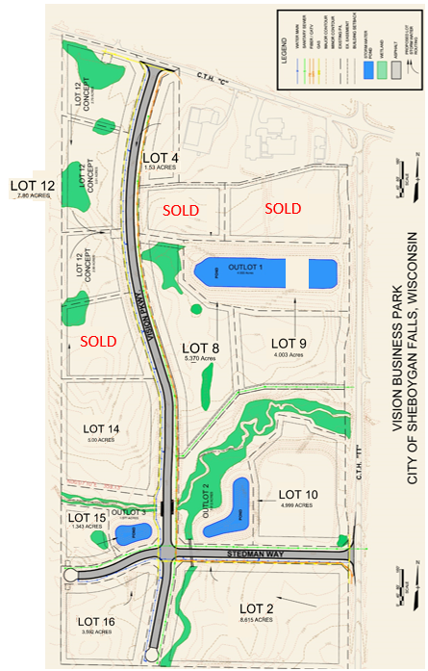
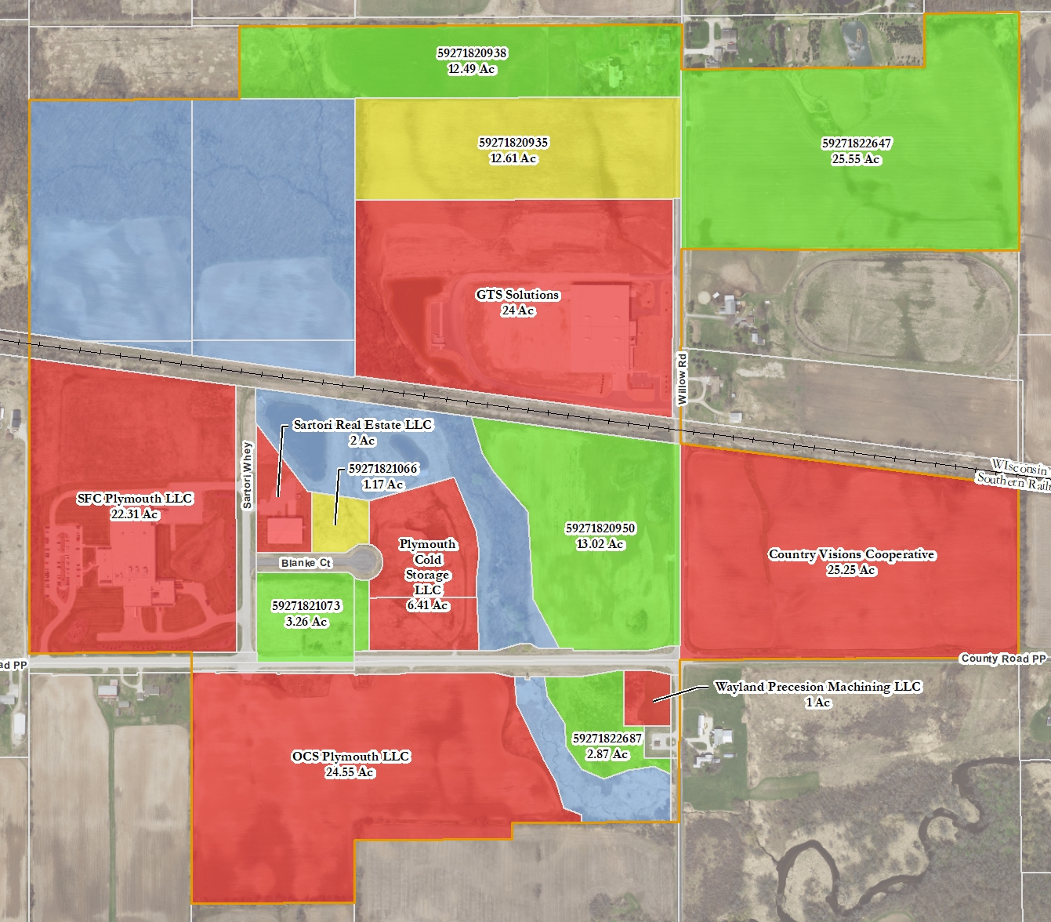
Solution Concept: Business Park
SOLD
Notes:
1990’s community allowed for a beautiful business park. It is full and we could prep more land if the right conditions exist.

Slide 38
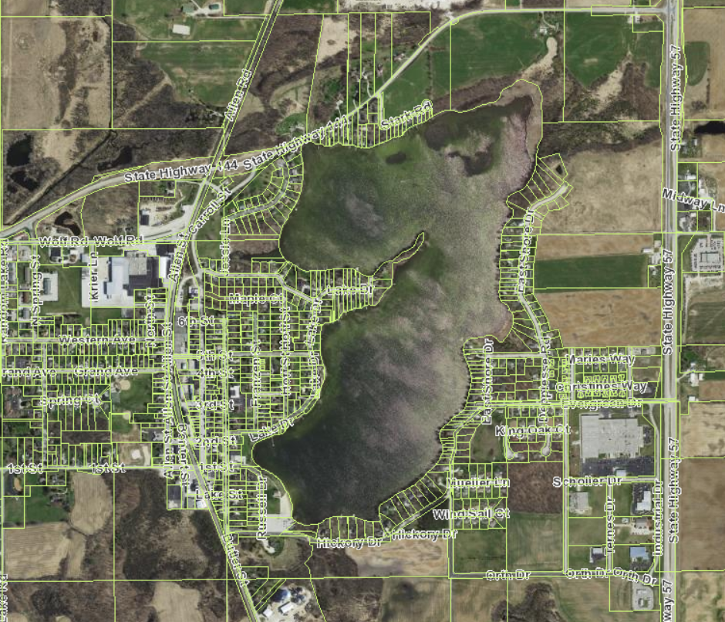
Our Asset – The Lake
Development Hotspots
Notes:
Development is likely to occur
Maximize parcels – property tax density

Slide 39

Change Conversation

Slide 40
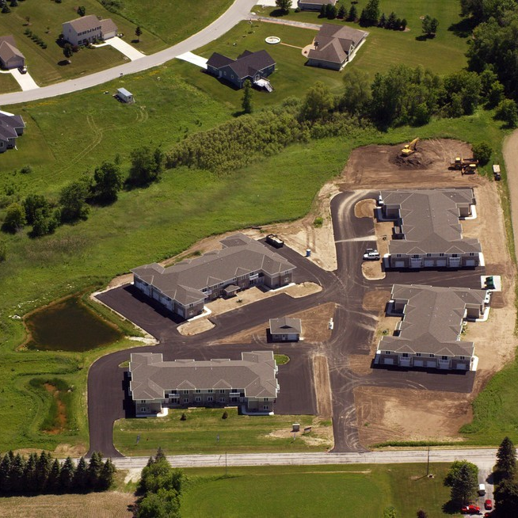
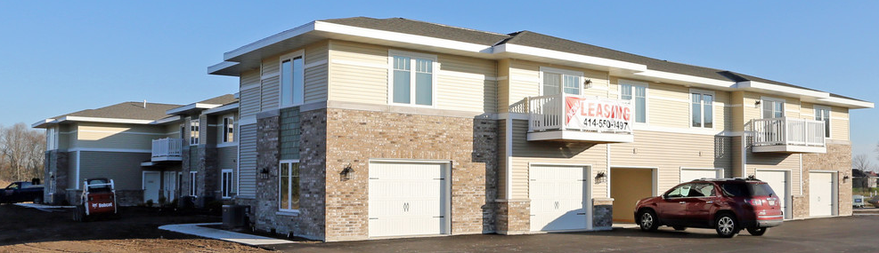
Example – The Preserve
Town of Sheboygan
$1,195 for 2BR, 2 BA, 1 Car
Standard 8-unit building type
Town sold land at $30,000/acre
No Incentives

Slide 41
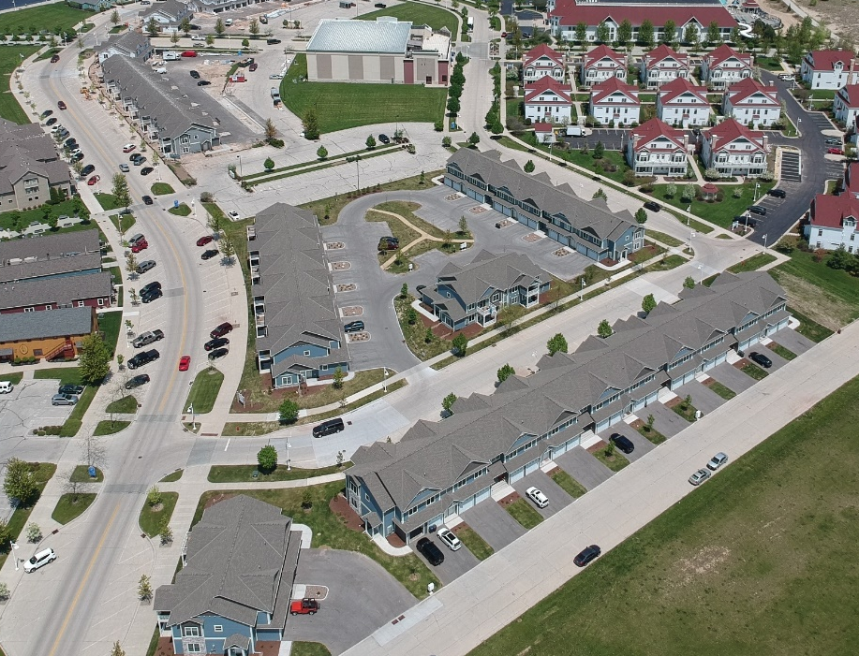
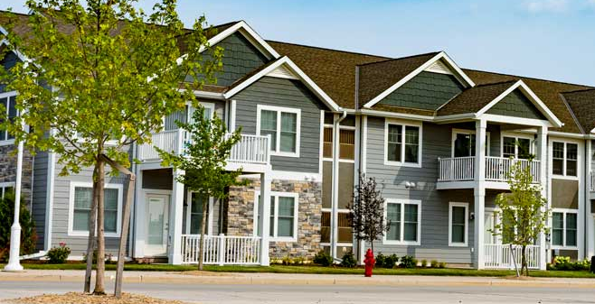
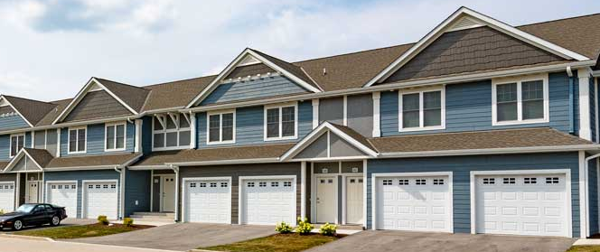
Example - Portscape
City of Sheboygan
$1,150 for 1 BR, 1 BA
$1,400 for 2 BR, 2 BR, 1 CAR
$1.7M TID ($19,300 / Unit)
City discount on land lease

Slide 42
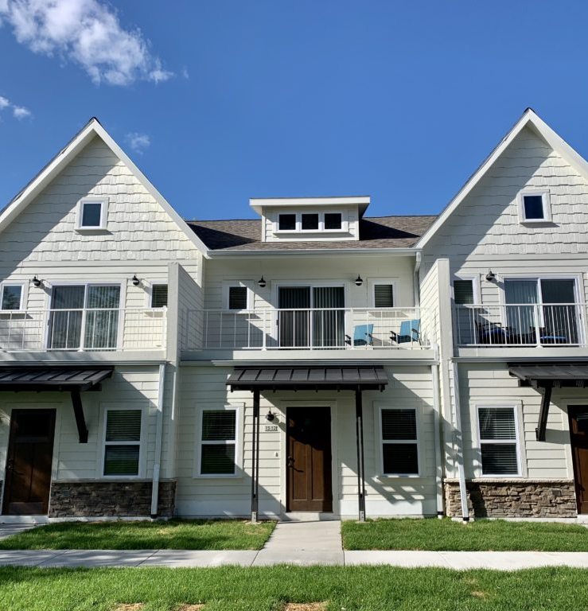
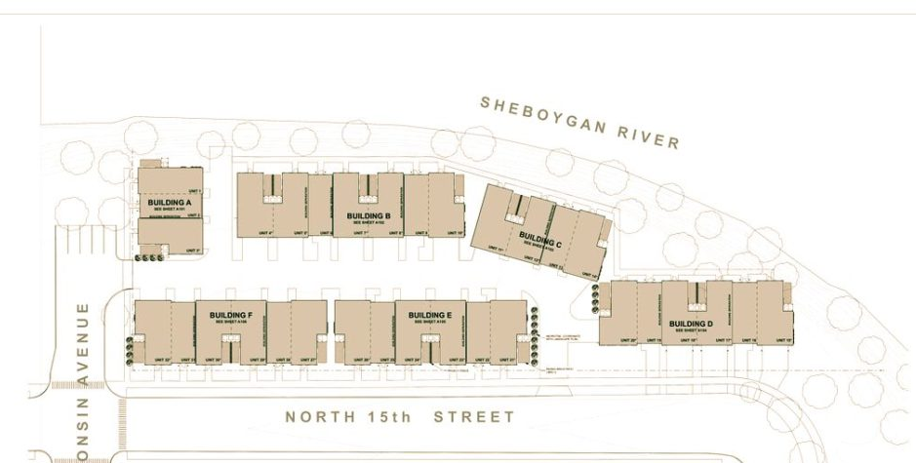
Example – Waters Edge
2BR, 2BA 2 Car - $260,000
~1,200 SF
$400,000 in TID / $12,000 per unit

Slide 43
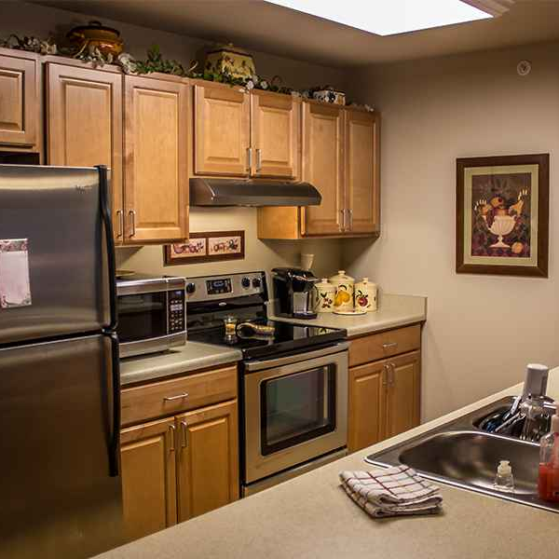
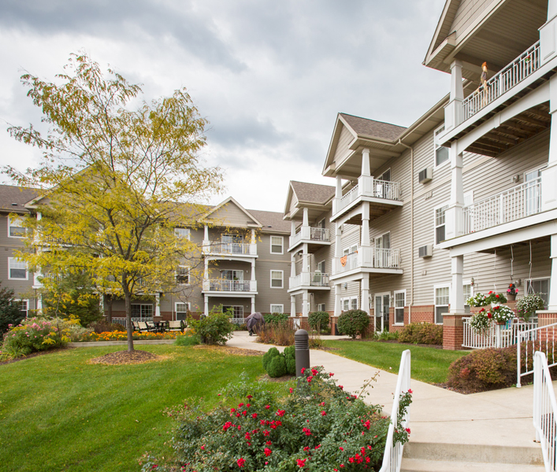
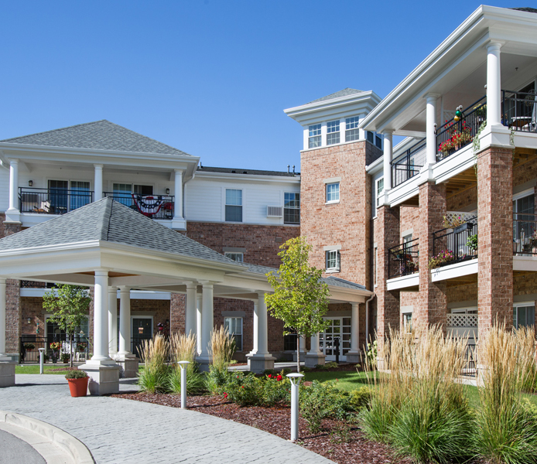
Example - Berkshire
Section 42 – Low Income
  >60% Median County Income
Senior Housing (55+)
Local TID used (varied by community)

Slide 44
Development Price Points
Berkshire Senior Community
The Preserve
Portscape
Waters Edge Condos

Slide 45
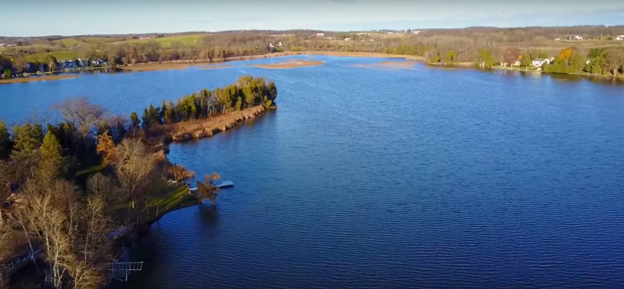
How can we?
Respectfully use the lake to encourage development that:
  Keeps our youth and seniors in the community?
  Increase housing capacity to meet employer needs?
  Maximize the few remaining parcels?
Proactively work on outdoor recreational amenities?
Partner to generate long-term revenue from untaxed Village property?
Take opportunities as they come knowing that growth is no longer “given?”

Slide 46
Ideas to consider
Village of Random Lake to form subcommittee(s) to consider the following:
  Study what other similar communities are doing to encourage development
  Assess to see if creating a Village Redevelopment Authority
  Put together guidelines (what the Village needs to make a determination) should a developer ask for public entitlements
  Plan and make recommendations to add an “Economic Development” section on municipal website

Slide 47

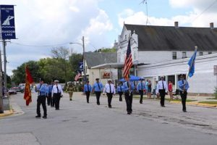



Thank You!
Notes:
This is all our community. We can’t thrive unless our neighbors thrives. We would like to thank everyone for your time and encourage logical, dense and environmentally sensitive development of our key asset while understanding we need to be flexible should unforeseen opportunities arise. Remember that rising tides lift all boats.

Slide 48
Tables / Stations
Comparable Developments & Architecture
  Brian Depies, SEH Engineering, architects & planners
  Cory Davis, Life-time resident & developer & finance
Land / Site Availability
  David Borchardt, Life-time resident & developer & finance
Employment Trends
  Ted Neitzke, Random Lake Chamber Executive Director
TIF & Entitlement Options
  Dane Checolinski, Sheboygan County Economic Dev’t Corp.
School Enrollment & Operations
  Mike Trimberger, Random Lake School District Administrator
Village Engineering Needs
  Robert McDermott, Village of Random Lake Village President
  Aaron Groh, Kapur & Associates Project Engineer
Notes:
This is all our community. We can’t thrive unless our neighbors thrives. We would like to thank everyone for your time and encourage logical, dense and environmentally sensitive development of our key asset while understanding we need to be flexible should unforeseen opportunities arise. Remember that rising tides lift all boats.

